Slide 1


Hope to Skills
Lecture# 26
Irfan Malik, Dr. Sheraz Naseer, Dr. Shazia Saqib, Haris

Slide 2
Agenda
Artificial Neural Networks
Hyper parameters
Learning rate
Epochs
Activation functions
Batch Size
Forward/Back Propagation
Limitations of Simple Neural Network

Slide 3
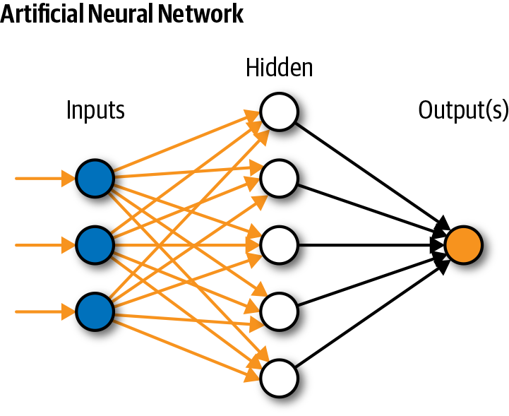
Simple Neural Network

Slide 4
Gradient Descent
A hyperparameter that controls the step size during gradient descent optimization. It determines how quickly the model adjusts its parameters in the direction that reduces the loss.
A higher learning rate might lead to faster convergence but risks overshooting, while a lower rate might slow down convergence.

Slide 5
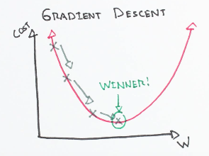
Gradient Descent

Slide 7
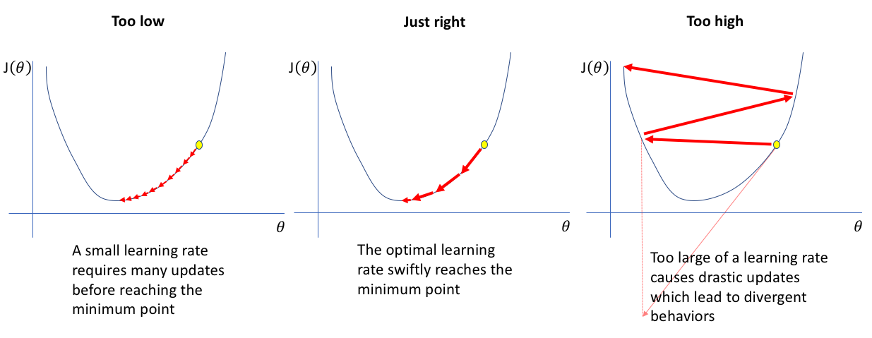
Learning Rate
A higher learning rate might lead to faster convergence but risks overshooting, while a lower rate might slow down convergence.

Slide 8
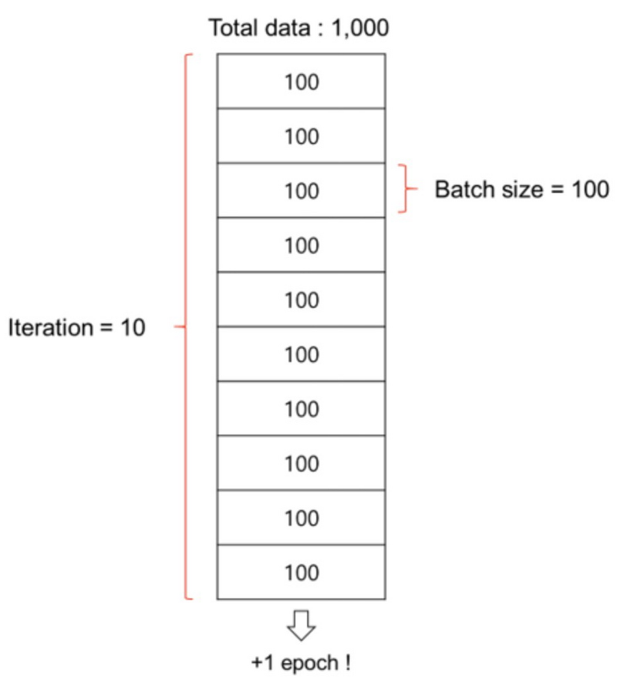
Batch Size
Batch is a subset of the training dataset used in each iteration of the training process.
Instead of processing the entire dataset
at once, we divide it into smaller batches.

Slide 9
Batch Size
Batch size is the number of training examples in each batch.
It's a hyperparameter that can be adjusted based on hardware limitations and dataset characteristics.
Larger batch sizes may speed up training but require more memory.

Slide 10
Number of Epochs
The number of times the entire training dataset is seen by the model during training.
Too few epochs might result in underfitting, while too many epochs can lead to overfitting.

Slide 11
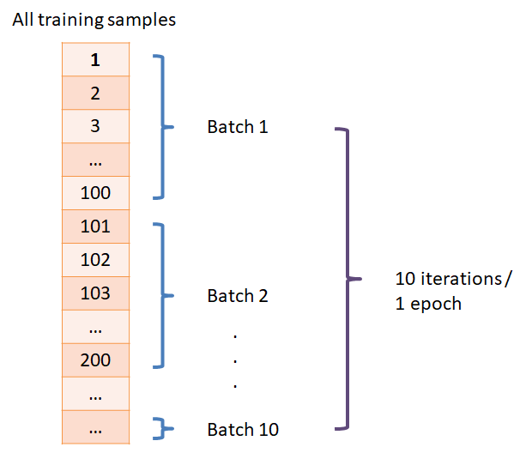
Number of Epochs

Slide 12
Activation Functions (Neuron)
It determine the functions applied to the outputs of each neuron to introduce non-linearity.
Common activation functions include
ReLU (Rectified Linear Unit) (0, ∞),
Leaky ReLU (-∞, ∞)
Hyperbolic Tangent (Tanh) (-1, 1)
Softmax (0, 1) used for Multiclass Classification
Sigmoid (0, 1) used for Binary Classification

Slide 13
Training of Neural Networks

Slide 14
Forward Propagation
Gif Courtesy: https://community.alteryx.com/t5/Data-Science/It-s-a-No-Brainer-An-Introduction-to-Neural-Networks/ba-p/300479

Slide 15
BackPropagation
https://datamapu.com/posts/deep_learning/backpropagation/#two_neurons

Slide 16
Forward and Back Propagation
Gif Courtesy: https://www.datacamp.com/tutorial/mastering-backpropagation

Slide 17
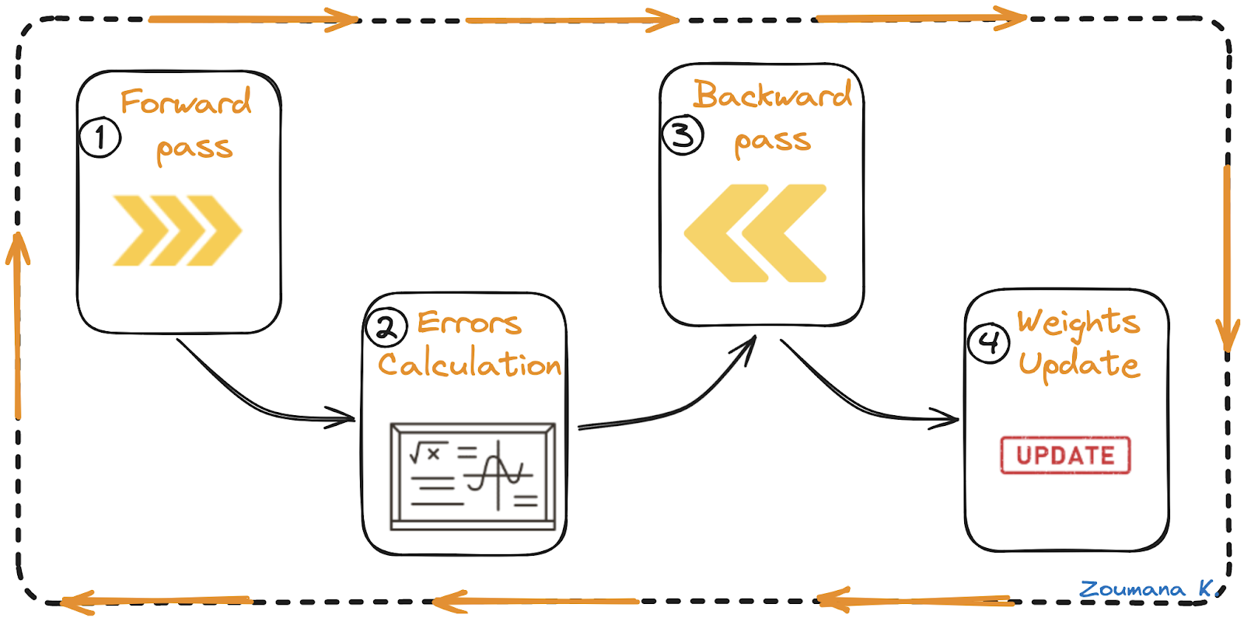
The Complete Training Process
Notes:
This diagram can be improved/recreated

Slide 18
Forward Pass
1. Input Data: Inputs (X1 and X2) are fed to the input layer.
2. Weighted Inputs: Each input is multiplied by its corresponding weight and sent to hidden layer neurons (N1X and N2X).
3. Activation: Hidden layer neurons apply an activation function to the weighted inputs, passing the results to the next layer.
Notes:
Should we mention bias here?

Slide 19
Error Calculation
1. Output Generation: The network processes inputs until the output layer produces the final output.
2 Comparison: The network's output is compared to the ground truth (desired output).
3. Error Calculation: The difference between the output and ground truth is computed, yielding an error value.

Slide 20
Backward Pass
1. Gradient Calculation: Use the error value to calculate the gradient of the loss function.
2. Error Propagation: Propagate the error gradient back through the network from the output layer to hidden layers.
3. Weight Updates: Update weights based on their contribution to the error, using the derivative of the error with respect to each weight.
4. Learning Rate: The size of weight updates is determined by the learning rate; smaller rates result in smaller updates.

Slide 21
Weights Update
1. Gradient Descent: Weights are adjusted in the opposite direction of the gradient to reduce error.
2. Iterative Process: Forward pass, error calculation, backward pass, and weight updates are repeated for multiple epochs.
3. Convergence: The process continues until network performance is satisfactory.

Slide 22
Limitations of Simple Neural Networks
Pixel Equality: Simple neural networks treat all pixels in an image equally, regardless of their spatial relationships or positions
High Dimensionality: Large sized Image have more pixels and model needs more weights to learn. 28x28=784, 256x256=65536
Limited Feature Extraction: Simple networks lack specialized layers to automatically extract relevant features from images, making it harder to identify complex structures

Slide 23
Limitations of Simple Neural Networks(Contd)
Large Computational Requirements: Larger no of weights requires more computational resources to train.
Overfitting Risk: More prone to overfitting due to a higher number of parameters.
Scalability Issues: Struggles with scaling to large, complex datasets efficiently.

Slide 24
Google Colab

Slide 25
Summary
Review of Forward and Back Propagation
Google Colab Practice

